Slide 1
More about Hypothesis Testing

Slide 2
One vs. two-tailed tests
Why doesn’t everyone just do one-tailed tests?
Two-tailed tests are standard practice in the behavioral sciences because they are more conservative. Remember, we want to resist making it easy to confirm our prior beliefs!
BUT don’t uncritically use two-tailed tests
Decide what your specific alternative hypotheses are ahead of time

Slide 3
CAN YOU MAKE A WRONG DECISION?

Slide 4

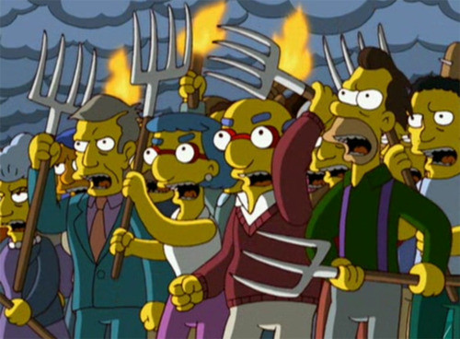
Two Ways To Be Wrong…
Notes:
Think of Aesop’s fable, “The Boy Who Cried Wolf.” In that story, a boy who watched the villager’s sheep was bored one day. So he decided to yell “wolf!” even though there wasn’t a wolf. The villagers believed there was a wolf and came running to save their sheep. Now, they were wrong in thinking that there was a wolf. (Type I Error)
The next day there was actually a wolf. The boy yelled, “wolf!” but nobody came because they believed there wasn’t a wolf. Again, they were wrong in their belief about the wolf. So there are two ways you can be wrong. (Type II Error)

Slide 5
Type I Errors (α)
A Type I error occurs when the sample data appear to show a treatment effect when, in fact, there is none
We reject a null hypothesis (H₀) that is actually true
We falsely conclude that the treatment has an effect
Caused by unusual, unrepresentative samples that fall into the critical region despite a null effect of the manipulation
Type I errors should be very unlikely; they occur at the rate at which we set our alpha (α)
Notes:
This is the first error in The Boy Who Cried Wolf.

Slide 6
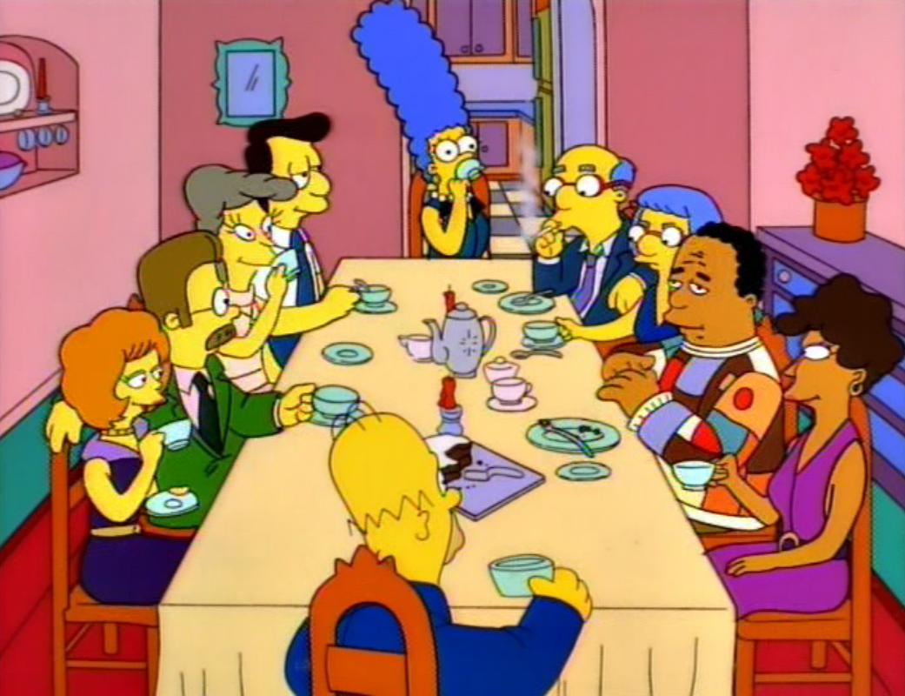
Two Ways To Be Wrong…
Notes:
Think of Aesop’s fable, “The Boy Who Cried Wolf.” In that story, a boy who watched the villager’s sheep was bored one day. So he decided to yell “wolf!” even though there wasn’t a wolf. The villagers believed there was a wolf and came running to save their sheep. Now, they were wrong in thinking that there was a wolf. (Type I Error)
The next day there was actually a wolf. The boy yelled, “wolf!” but nobody came because they believed there wasn’t a wolf. Again, they were wrong in their belief about the wolf. So there are two ways you can be wrong. (Type II Error)

Slide 7
Type II Errors (β)
A Type II error occurs when the sample does not appear to have been affected by the treatment when in fact, it has (the treatment does have an effect)
We fail to reject the null hypothesis (H₀) that is actually false
We falsely conclude that the treatment had no effect
Commonly the result of…
… a very small effect of our manipulation/treatment
… a very small sample size (n)
… large variability in our sample data
Notes:
This is the second error in the Boy Who Cried Wolf.
Although the treatment does have an effect, it is not large enough to show up in our data

Slide 8
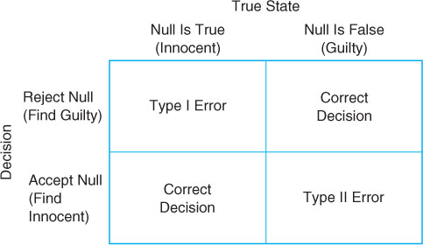
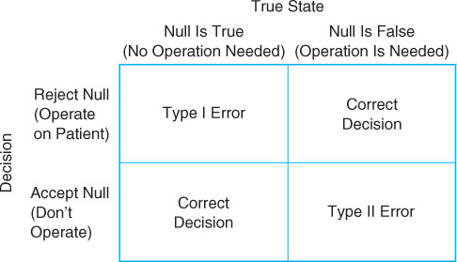
Errors in Context
Jurors’ Decision Matrix
Doctors’ Decision Matrix

Slide 9
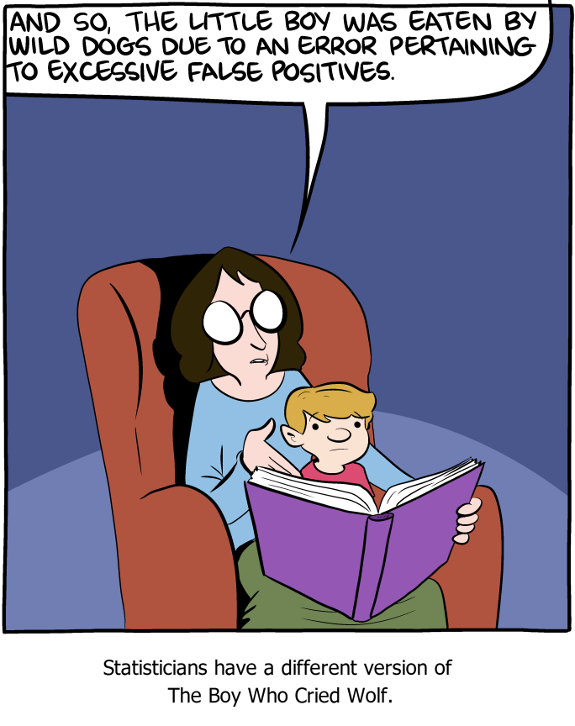

Slide 10
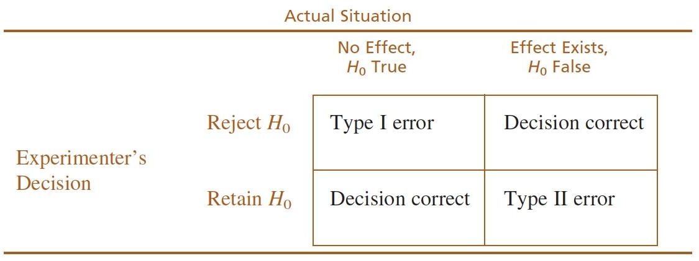
The Relationship Between α & Errors
The alpha (α) level is the probability of a Type I error
If α = .05: The probability that the test will lead to a Type I error is 5%
If α = .01: The probability that the test will lead to a Type I error is 1%
How does changing α influence Type II errors?
As we make α smaller, we decrease the chance of making a Type I error.
However, we also make it harder to reject the null; thus increasing the risk of a Type II error

Slide 11
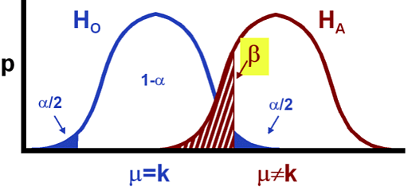
 | H₀ is TRUE | H₀ is FALSE
Reject H₀ | Type I Error “Crying Wolf” p(reject|H₀) = α | Correct Decision p(reject|H₁) = 1- β Also called power of the test
Fail to Reject H₀ | Correct Decision p(retain|H₀) = 1- α | Type II Error “False Negative” P(retain|H₁) = β
How to decrease Type I Error?
How to decrease Type II Error?

Slide 12
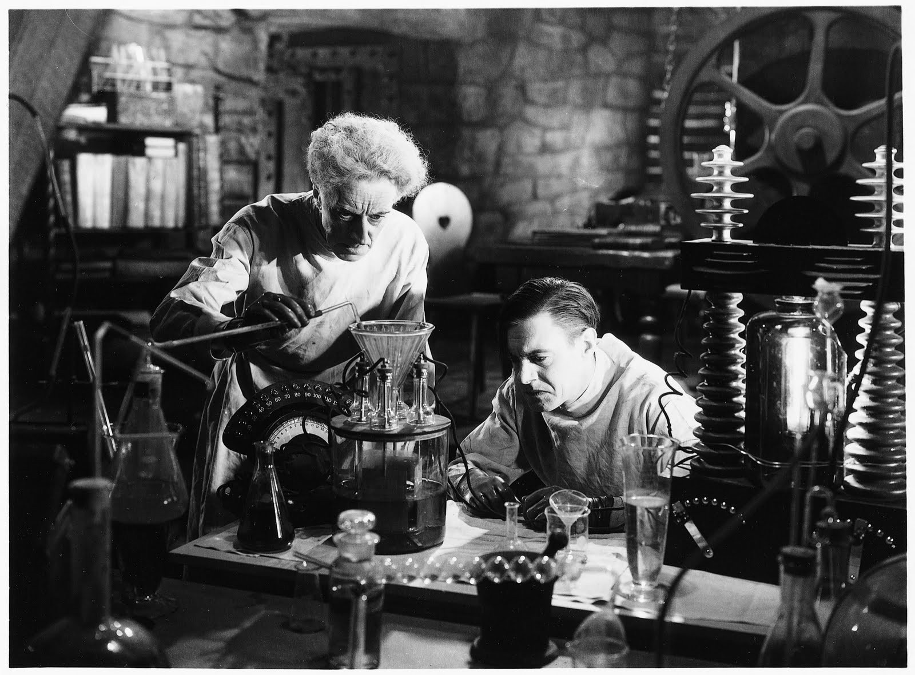
Experiment Design
Research Methods 1

Slide 13
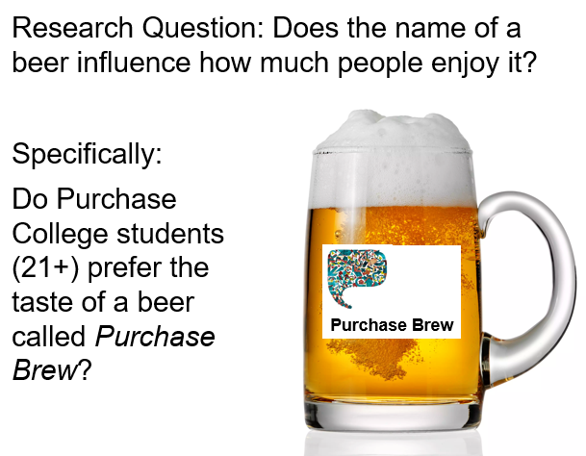

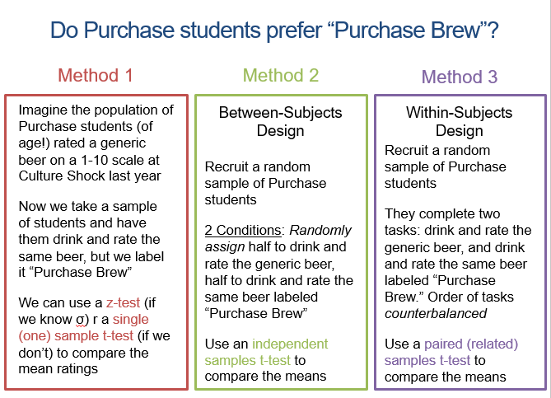
Notes:
Recall our discussions on the various t-tests available to us. All of those methods involve the comparison of means.

Slide 14

Experimental Methods
Notes:
But how do we get these data?

Slide 15
Experimentation
Overall Goals:
Demonstrate that changes in one variable cause changes in another
Rule out the possibility of another (third) variable causing changes
Tools for achieving goals:
Manipulation: Identify specific values of the IV to examine and create corresponding conditions or trials
Control: Ensure that the observed relationship is not contaminated by the influence of other variables
Notes:
Overall goal: e.g., that violent video games CAUSE aggression; that anchors of different sizes CAUSE different estimates of pop of purch
Identify specific values of the IV to examine and create corresponding treatment conditions
Determines directionality
Offers support for or against a third variable
Manipulation also allows us to resolve the third-variable problem. If we were to look just at the consumption and crime rates, we might believe that a relationship exists. However, we have to take into account the possible third variable – the temperature that influences both, independent of each other.
In order to show that the changes seen in the DV are the direct result of the manipulations to the IV, we must rule out any other possible explanation for the change – in other words, we must eliminate the possibility of a confounding variable.
Illustrated in the study examining the role of humor in memory by Schmidt (1994).
Generated pairs of humorous and nonhumorous sentences that had the same basic content
Humorous: if at first you don’t succeed, you are probably not related to the boss
Non-humorous: People who are related to the boss often succeed the very first time.
Participants were then given a list of sentences followed by memory test on recall of sentences
RESULTS: recall of more humorous sentences than non-humorous sentences
Possible confound: surprise at humor in an otherwise boring experiment may have caused memory to increase for humorous sentences
REDO: participants were told half sentences would be humorous, eliminating surprise
RESULTS: now we can know if results are based on manipulation of IV and NOT confound
The radio study in the text: strong relationship between the number of radios in the population and birth control practices: the higher the number of radios, the higher use of contraception (and resultant lower number of children in households).
The crux of the experimental research paradigm is to isolate the variable of interest from all co-related variables and manipulate that in order to determine if there is a cause-and-effect relationships. However, as we’ve been discussing, it is very difficult to tease out one variable from the naturally co-occurring ones.
Directionality
A second problem is the directionality problem. While it is relatively simple to establish a relationship between two variables, the problem usually lies in establishing the type of relationships the two variables share. Which one causes which?
CLICK
In order to establish a cause-and-effect relationship between two variables, we have to control nature – by creating an unnatural situation wherein variables exist in isolation from other confounding variables.
Causation and the third-variable problem
The summertime murder rates/ice cream sales study
Is there a confounding variable?
Causation and the directionality problem
Which one causes the other?
Self-esteem and grades have a high positive correlation. How might these concepts contradict a causal claim that higher self-esteem results in better test grades?
Controlling Nature
Create an unnatural situation where variables exist in isolation

Slide 16
Non-Experimental vs. Experimental Methods
NON-EXPERIMENTAL
EXPERIMENTAL
Can demonstrate relationships (e.g., correlations) between variables, but not causality
No random assignment; participants simply observed and measured
No manipulation of any variables
Often there is a lack of rigorous control by experimenter in the name of naturalistic observation
Intended to answer cause and effect questions about relationships between variables
Participants randomly assigned to different groups or conditions
Independent variable manipulated by experimenter
Rigorous control over experimental setting, variables, and materials

Slide 17
Example Experimental Design
Observation:
Students are using laptops in lectures
”Does laptop use in class have an effect on students’ retention of information presented in class?”
Hypothesis:
Using a laptop leads to lower grades
Random assignment to “laptop” or “no laptop” groups
Experimental group = use laptop
Control group = do not use laptop
Manipulate Independent Variable:
Students use
laptops
Students don’t
use laptops
You should control extraneous factors:
- Lecture content
- Exam questions
Measure Dependent Variable:
Test of lecture material
Results: (Group test score means)
Laptop: 52% No Laptop: 63%
Notes:
Inferences of cause and effect require three elements:
Temporal precedence
Covariation between the two variables
Need to eliminate plausible alternative explanations

Slide 18
Key Features of Experiments
Manipulation
Measurement
Control
Independent Variable
The variable you think causes (predicts) a change in behavior; usually is manipulated by the experimenter
Dependent Variable
The response outcome or behavior you measure that you think is affected by (depends on) the IV
Extraneous Variables
Any other variables in your study that may influence the DV that must be controlled:
Demographics
Ambient environment
Notes:
Independent Variables: The variables that are considered to be the “cause”
Usually manipulated by the researcher
Dependent Variables: The variables that are considered to be the “effect”
Changes in these variables are dependent on changes in the independent variable
This is the response variable measured by the researcher

Slide 19
Basic research designs
Between- and Within-Subjects Designs

Slide 20
Basic Research designs
Within-Subjects Designs
The different levels of the independent variable are experienced by all participants in the study. Requires just one group of participants (AKA repeated-measures design)
Between-Subjects Designs
Participants experience one, and only one, level of the independent variable. Requires multiple independent groups of participants (AKA independent groups design).
Notes:
Drug trials tend to be between subjects designs. WHY? Experimental vs. Control or Baseline group. Placebo effects…

Slide 21
Within-Subjects Designs
A single group of participants undergoes all of the different treatment conditions (levels of the IV)
Each individual is tested/observed in all treatment conditions
This is why it’s called repeated-measures design
Notes:
NOTE THAT WE ARE TALKING ABOUT BETWEEN-SUBJECTS EXPERIMENTAL DESIGN – THERE ARE OTHER TYPES OF BETWEEN-SUBJECTS DESIGN (NON-EXPERIMENTAL, QUASI-EXPERIMENTAL).
The defining characteristic of the between-subjects experimental design is that we are comparing scores of different groups of individuals.
The steps to the research in a between-subject design is:
We manipulate the IV to create different treatment conditions
Participants are assigned to only one of (in this case) three conditions
We then measure the DV for each individual within these groups
We compare the scores to see if there are any differences between groups
Another characteristic of the between-subjects experimental design is that it allows for only one score for each participant.
Each participant is exposed to only one level of the IV
If there are 30 scores in treatment 1, 30 in treatment 2 and 30 in treatment 3, we know there were 30 participants in each treatment condition

Slide 22
Within-Subjects Designs
In the Stroop Task, all participants complete both Consistent and Inconsistent trials
Consistent
Blue
Green
Purple
Red
Orange
Blue
Inconsistent
Blue
Green
Purple
Red
Orange
Blue
Press a button as fast as possible to indicate the color of the font
Notes:
NOTE THAT WE ARE TALKING ABOUT BETWEEN-SUBJECTS EXPERIMENTAL DESIGN – THERE ARE OTHER TYPES OF BETWEEN-SUBJECTS DESIGN (NON-EXPERIMENTAL, QUASI-EXPERIMENTAL).
The defining characteristic of the between-subjects experimental design is that we are comparing scores of different groups of individuals.
The steps to the research in a between-subject design is:
We manipulate the IV to create different treatment conditions
Participants are assigned to only one of (in this case) three conditions
We then measure the DV for each individual within these groups
We compare the scores to see if there are any differences between groups
Another characteristic of the between-subjects experimental design is that it allows for only one score for each participant.
Each participant is exposed to only one level of the IV
If there are 30 scores in treatment 1, 30 in treatment 2 and 30 in treatment 3, we know there were 30 participants in each treatment condition

Slide 23
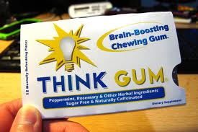
Demand characteristics
Imagine that you were asked to memorize a list of words and then you were tested on the words.
Then imagine that I gave you a piece of ThinkGum
Now imagine that you did that task again the next day.

Slide 24
Carryover effects
Imagine I am testing your running speed.
Day 1: You run 1k
Day 2: You run 2k
Day 3: You run 3k
Do you think you would get faster each day? Why?

Slide 25
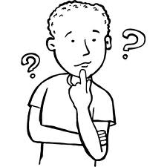
Practice effects
Imagine that you were asked to memorize a list of words and then you were tested on the words.
Now imagine that you did that task again the next day…
And the next day…
And the next day…

Slide 26
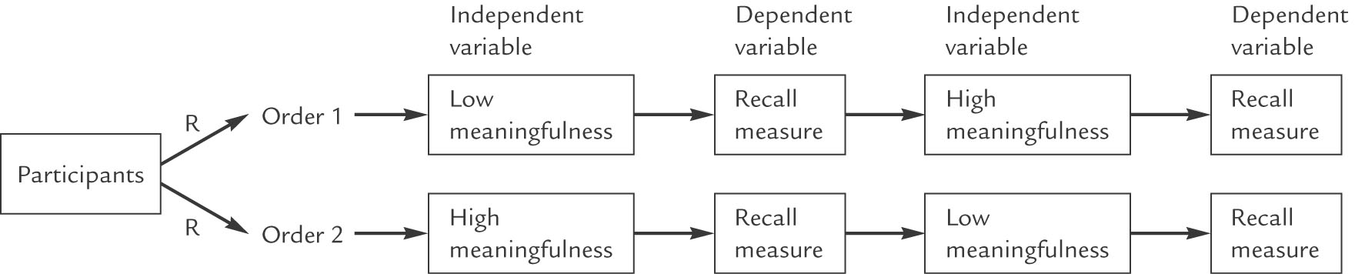
Dealing with Order Effects
Counterbalancing: Changing the order in which treatment conditions are administered from one participant to another so that the treatment conditions are matched with respect from time
Evenly distributes order effects but does not eliminate them

Slide 27
Within-Subjects Designs
Advantages
Disadvantages
Participants serve as their own controls, which eliminates variance due to individual differences
More efficient: Fewer participants needed, and more sensitivity/power to detect differences
Carryover Effects: changes in behavior or performance caused by the lingering after-effects of an earlier treatment condition (an order effect)
Practice effects: influence on performance that arises from practicing a task
Demand characteristics: An experimental artifact that allows participants to form an interpretation of the experiment's purpose (and unconsciously change their behavior to fit that interpretation)
Notes:
Mention ORDER EFFECTS
Advantages
So we already talked about the advantage of independent scores: we can rest assured that the scores we obtain from each individual aren’t contaminated by other experimental factors like:
Practice effects
Fatigue effects
Environmental effects
Another advantage is that we can use between-subjects design for any research question that involves a comparison of one group to another – and since most experimental research involves a comparison between groups, the between-subjects design is always an option and readily available.
Disadvantages
A disadvantage is that this design requires a large group of participants –
Because we are obtaining independent scores, we usually need many participants to fulfill the minimum requirements for number of participants.
This may not be an issue if we are conducting a study on college students, but if we were interested in looking at a special population with particular characteristics (disease, disorder, ethnicities, etc.), then we might find our sample to be very limited.
The biggest disadvantage, however, is the nature of the design itself – the fact that you are obtaining measurements from individuals –
remember that there is always this notion of individual differences between participants – that each participants comes into the experiment with pre-existing differences
Height, weight, gender, personality, preferences, etc.
For between-subject experimental design, individual differences can create serious problems:
Can become confounding variables
Differences between treatments could be attributed to differences between the partcipants in treatments A and B – is one group older? Etc.
Can result in highly variable scores
Differences between individuals can produce highly variable scores

Slide 28
Between-Subjects Designs
Comparing scores of different individuals
Independent Scores:
Each participant exposed to only 1 level of the IV
Manipulation →
Notes:
NOTE THAT WE ARE TALKING ABOUT BETWEEN-SUBJECTS EXPERIMENTAL DESIGN – THERE ARE OTHER TYPES OF BETWEEN-SUBJECTS DESIGN (NON-EXPERIMENTAL, QUASI-EXPERIMENTAL).
The defining characteristic of the between-subjects experimental design is that we are comparing scores of different groups of individuals.
The steps to the research in a between-subject design is:
We manipulate the IV to create different treatment conditions
Participants are assigned to only one of (in this case) three conditions
We then measure the DV for each individual within these groups
We compare the scores to see if there are any differences between groups
Another characteristic of the between-subjects experimental design is that it allows for only one score for each participant.
Each participant is exposed to only one level of the IV
If there are 30 scores in treatment 1, 30 in treatment 2 and 30 in treatment 3, we know there were 30 participants in each treatment condition
a.k.a. Independent-measures Experimental Design
Requires a separate, independent group of individuals for each treatment condition
Data contains only one score per participant
Difference from other between-subjects design:
Manipulation of an independent variable
Control of extraneous variables
Goal: To determine if differences exist between two or more treatment conditions
One of the major advantages of the between-subjects experimental design is that each score obtained is independent of other scores.
Meaning, since we are only testing each participant once, we can be reasonably reassured that the scores we get are uncontaminated by things like fatigue, etc.
This is why we also call this the independent-measures experimental design.
GO THROUGH SLIDE
The general goal is to determine if differences exist between two or more treatment conditions. If there are differences (fitting our predictions), then we can determine that the IV caused a change in the DV – thus allowing us to say that there is indeed a cause-and-effect relationship, which is the overall goal of an experimental design.

Slide 29
Small Anchors
Large Anchors
Is the number of biology majors at Purchase College more or less than 55 students?
Does the Neuberger museum on campus have more or less than 16 famous paintings in its collection?
Have Purchase College alumni won more or less than 8 Grammy Awards (for music or music production)?
Is the total population of Purchase College (students + faculty + staff) more or less than 2000 people?
Are there more or less than 14 student run organizations and clubs on campus at Purchase?
Is the number of biology majors at Purchase College more or less than 255 students?
Does the Neuberger museum on campus have more or less than 96 famous paintings in its collection?
Have Purchase College alumni won more or less than 38 Grammy Awards (for music or music production)?
Is the total population of Purchase College (students + faculty + staff) more or less than 6000 people?
Are there more or less than 54 student run organizations and clubs on campus at Purchase?
Notes:
Between or within subjects?
How could I have made it both?

Slide 30
Between-Subjects Designs
Advantages
Disadvantages
Each score is independent of other scores
Participants less likely to figure out the purpose of the study (fewer demand characteristics)
Useful for any research comparing treatment groups
Lower power = requires many participants
Individual differences across groups (extraneous variables) may result in:
Confounding variables
Can result in highly variable scores
Notes:
Advantages
So we already talked about the advantage of independent scores: we can rest assured that the scores we obtain from each individual aren’t contaminated by other experimental factors like:
Practice effects
Fatigue effects
Environmental effects
Another advantage is that we can use between-subjects design for any research question that involves a comparison of one group to another – and since most experimental research involves a comparison between groups, the between-subjects design is always an option and readily available.
Disadvantages
A disadvantage is that this design requires a large group of participants –
Because we are obtaining independent scores, we usually need many participants to fulfill the minimum requirements for number of participants.
This may not be an issue if we are conducting a study on college students, but if we were interested in looking at a special population with particular characteristics (disease, disorder, ethnicities, etc.), then we might find our sample to be very limited.
The biggest disadvantage, however, is the nature of the design itself – the fact that you are obtaining measurements from individuals –
remember that there is always this notion of individual differences between participants – that each participants comes into the experiment with pre-existing differences
Height, weight, gender, personality, preferences, etc.
For between-subject experimental design, individual differences can create serious problems:
Can become confounding variables
Differences between treatments could be attributed to differences between the partcipants in treatments A and B – is one group older? Etc.
Can result in highly variable scores
Differences between individuals can produce highly variable scores

Slide 31
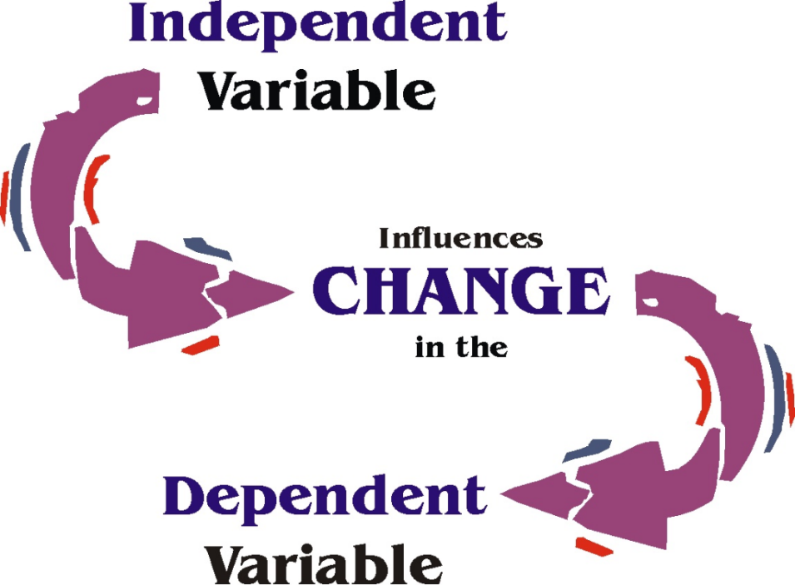

Slide 32
So let’s discuss variables
Independent Variable (IV)
Dependent Variable (IV)
Extraneous Variables

Slide 33

Manipulating the independent variable

Slide 34
Types of Manipulation
Straightforward Manipulation
Most studies utilize straightforward manipulation
Levels may be different types of stimuli or environment
Easy to interpret
e.g., Loftus’ Loaded Questions study (No leading question/Leading question)

Slide 35
Types of Manipulation
Staged Manipulation (a.k.a. Event Manipulation)
Can get complicated
Use of a confederate or accomplice
Designed to get participants involved in a “real” experience
May be difficult to replicate
e.g., authority figure present and heart patient “learner”

Slide 36
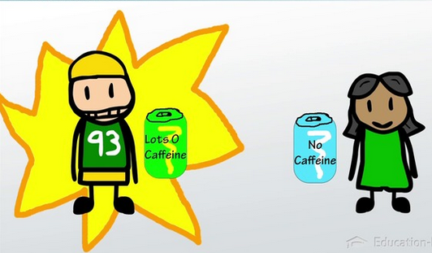
Manipulation Strength
Strong manipulation → maximizes differences between groups
i.e., no treatment vs. full treatment

Slide 37
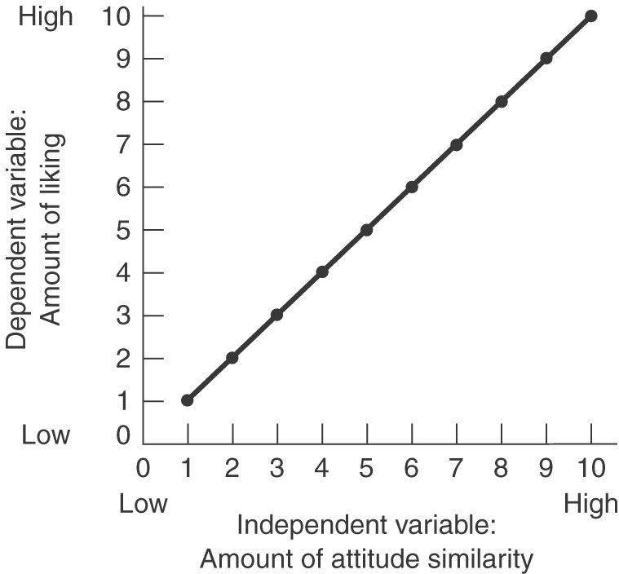
Example
Study on Attitude Similarity and Liking
Do birds of a feather flock together?
IV: Similarity; DV: Liking
1,1 = least similarity, least liking
10,10 = most similarity, most liking
A strong manipulation would be comparing 1,1 to 10,10
However, there are times that you need more nuanced information

Slide 38
Manipulation Check
An additional measure to assess how participants perceived and interpreted the manipulation and/or to assess the direct effect of the manipulation
Explicit measure of the IV (mood questionnaire)
Ask questions after participation (participants)
Particularly useful when there are:
Participant manipulations
Subtle manipulations
Simulations
Placebo Controls

Slide 39
Considerations
Subtlety
External validity (mundane & psychological realism)
Construct Validity
Confounding variables
Ethics
Costs
Notes:
You want to be subtle enough that they don’t know what you’re trying to do to them (avoid demand effects, reactance). Not too subtle that they don’t notice it (Manipulation checks)
Make it put people at least in the same psychological mindset that they would be in that situation, or can it put them into the actual situation
Are you actually manipulating what you want? Sometimes your manipulation can get too far afield from what you intended
Are you manipulating other things? If this is necessary, are there ways to measure and control for those variables? Can you run another study to correct it?

Slide 40
Can You Afford It?
Limited $$ equals:
Limited use of equipment and supplies
Limited salaries for confederates
Limited incentives for participants
May want a short experimental session
Difficult to recruit participants for multi-session studies or follow-ups
Limited space to conduct experiments
…which is why most use straightforward manipulation

